Slide 1
Project Proposal: Interactive Web-based "Sunburst Chart" Family Tree Management
August 2023
University of Western Australia

Slide 2
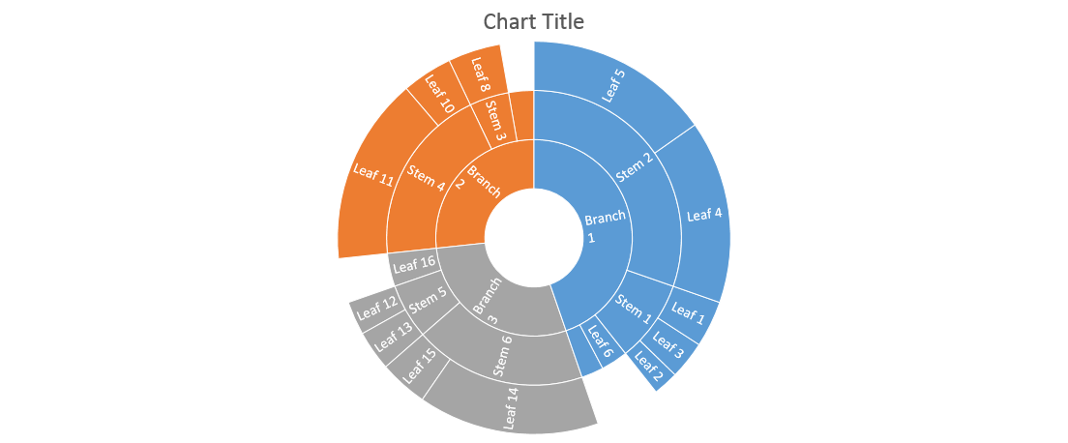
Introduction: Sunburst chart

Slide 3
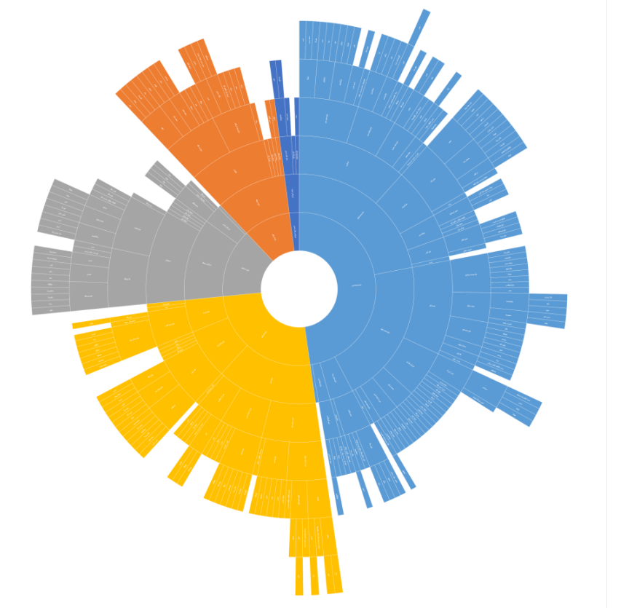
Introduction: Sunburst chart – crude attempt of family Tree

Slide 4
Interactive family tree – sunburst chart
website creation (collecting data and displaying the sunburst chart)
Database for management of entries.
Commenting System:
Visitors can provide comments on specific chart elements (by clicking on the entries), fostering communication and sharing of memories among family members.
User Authentication: Secure login functionality for administrators and users, ensuring data privacy

Slide 5
Interactive family tree – sunburst chart
Data collection via web (biography, pictures, …)
Displaying data in Sunburst chart
Display sunburst chart in mobile/desktop browser (Zoom and pan)
Selecting entries of the sunburst chart by a third party to submit additional data via web
Local display of sunburst chart by Administrator (Print, export, etc.)

